Slide 1
Invertible
Notes:
If AB = $I_{n}$ or BA = $I_{n}$ then A is invertible with inverse B and B is invertible with inverse A.
Listed another theorem

Slide 2

Unique Inverse
Notes:
Invertible matrices only have one inverse.

Slide 3
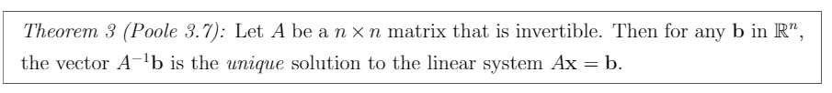
Invertible Unique Solution
Notes:
$A^{−1}b$ = x in Ax = b

Slide 4
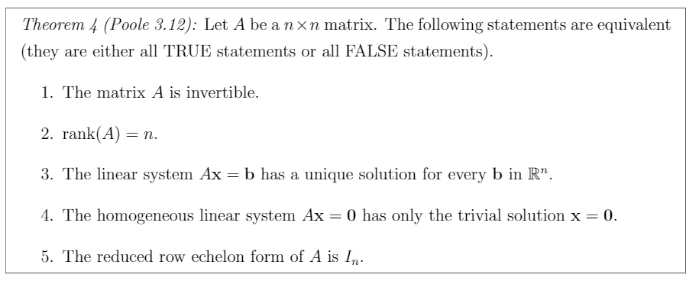
Fundamental Theorem of Invertible Matrices
Notes:
A is invertible
rank(A) = n
Ax=b has no free variables and zero rows (excluding b).
Homogenous linear system Ax = 0 has only trivial solution x = 0.
A reduces to $I_{n}$

Slide 5
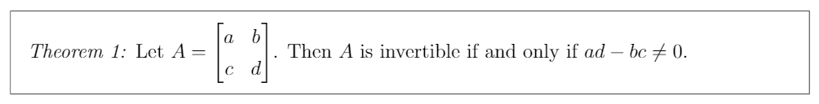
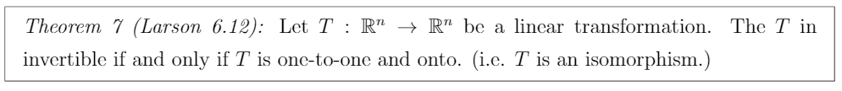
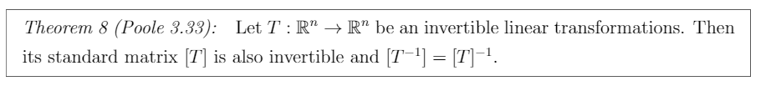
Other Invertible Properties

Slide 6
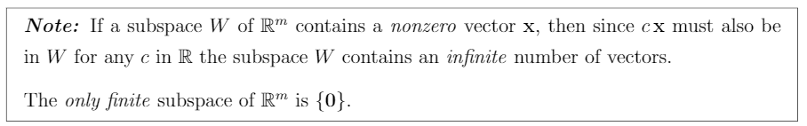
Finite, infinite subspaces
Notes:
Subspace contain every linear combination of nonzero vectors contained in it.
Only subspace {0} is finite.

Slide 7

Subspace
Notes:
The linear combination of the vectors in $R^{m}$ named W is a subspace of $R^{m}$.

Slide 8
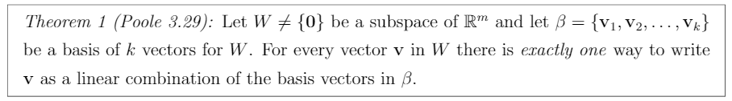
Basis
Notes:
Basis is the set of linearly independent vectors that represent subspace W which is not an empty set. (refer to slide 6)

Slide 9
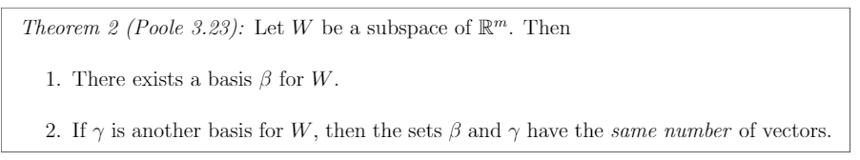
Subspace’s basis
Notes:
Any subspace W has:
A basis β for W
If another basis γ exist, β and γ have same number of vectors.

Slide 10
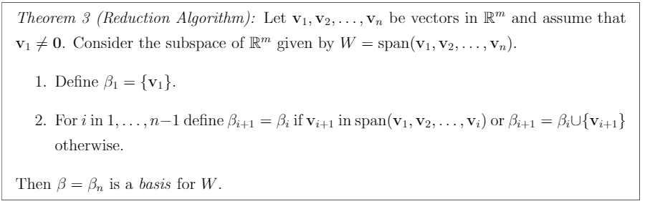
Reduction Algorithm
Notes:
Basically, how find the basis from a set of vectors. Look at the notes if you forgot how to find basis.

Slide 11
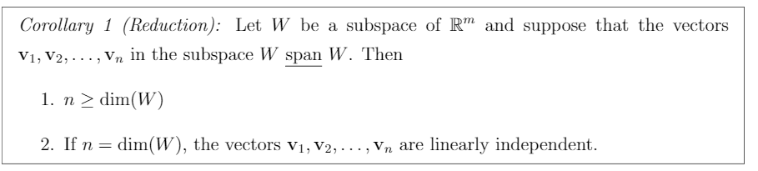
Reduction Corollary
Notes:
If the vectors $v_{1}$,…,$v_{n}$ in subspace W span W then:
n ≥ dim(W) (in order to span R2 for instance, we need at least 2 vectors).
If n = dim(W), $v_{1}$,…,$v_{n}$ are linear independent. (If we have 2 vectors in R2 that span R2, they must be pointing in different directions).
Note that n is the number of vectors in $v_{1}$,…,$v_{n}$.

Slide 12
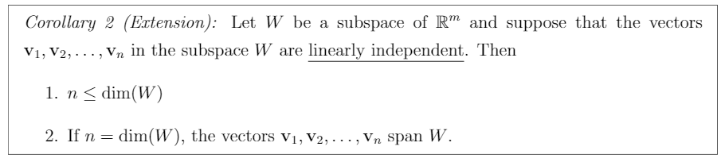
Extension Corollary
Notes:
If the vectors $v_{1}$,…,$v_{n}$ in subspace W are linearly independent then:
n ≤ dim(W) (Linear independent vectors cannot be reduced, therefore, the upper limit of n is the number of vectors in W).
If n = dim(W), $v_{1}$,…,$v_{n}$ span W. (If W consists of only linearly independent vectors, then those vectors generate all of W).

Slide 13
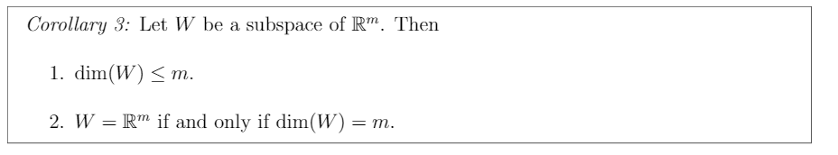
Subspace Properties
Notes:
If W is a subspace of $R^{m}$ then:
1. dim(W) ≤ m (If you have 3 linearly independent vectors, there exists 3 components in W (xyz) so W cannot exist in R2).
2. W = $R^{m}$ if and only if dim(W) = m (If you have 2 linearly independent vectors, they span R2, no exceptions)

Slide 14
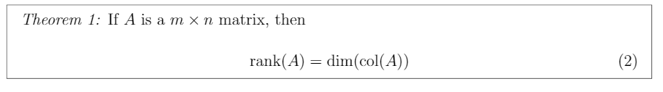
Rank & Column Dimension

Slide 15
Null and Subspace

Slide 16
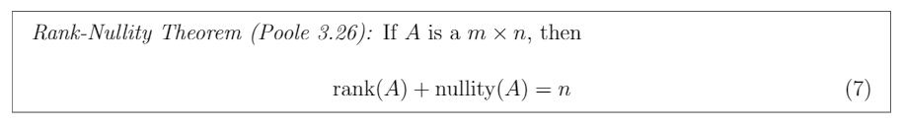
Rank Nullity Theorem

Slide 17
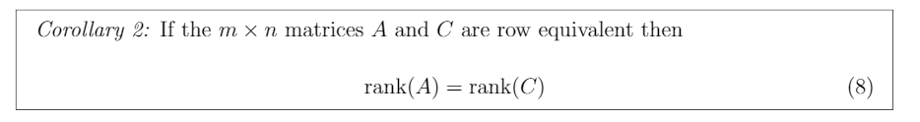
Row Equivalent Rank

Slide 18
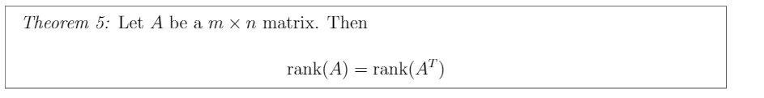
Rank vs Rank Transpose

Slide 19
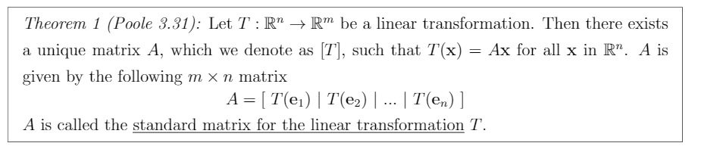
Standard Matrix

Slide 20
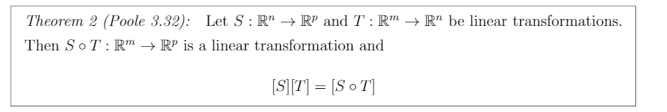
Standard Matrix Multiplication

Slide 21
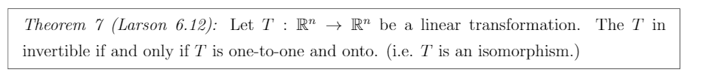
Isomorphism

Slide 22
Invertible Linear Transformation and Standard Matrix

Slide 23
Invertible Linear Transformation and Standard Matrix

Slide 24
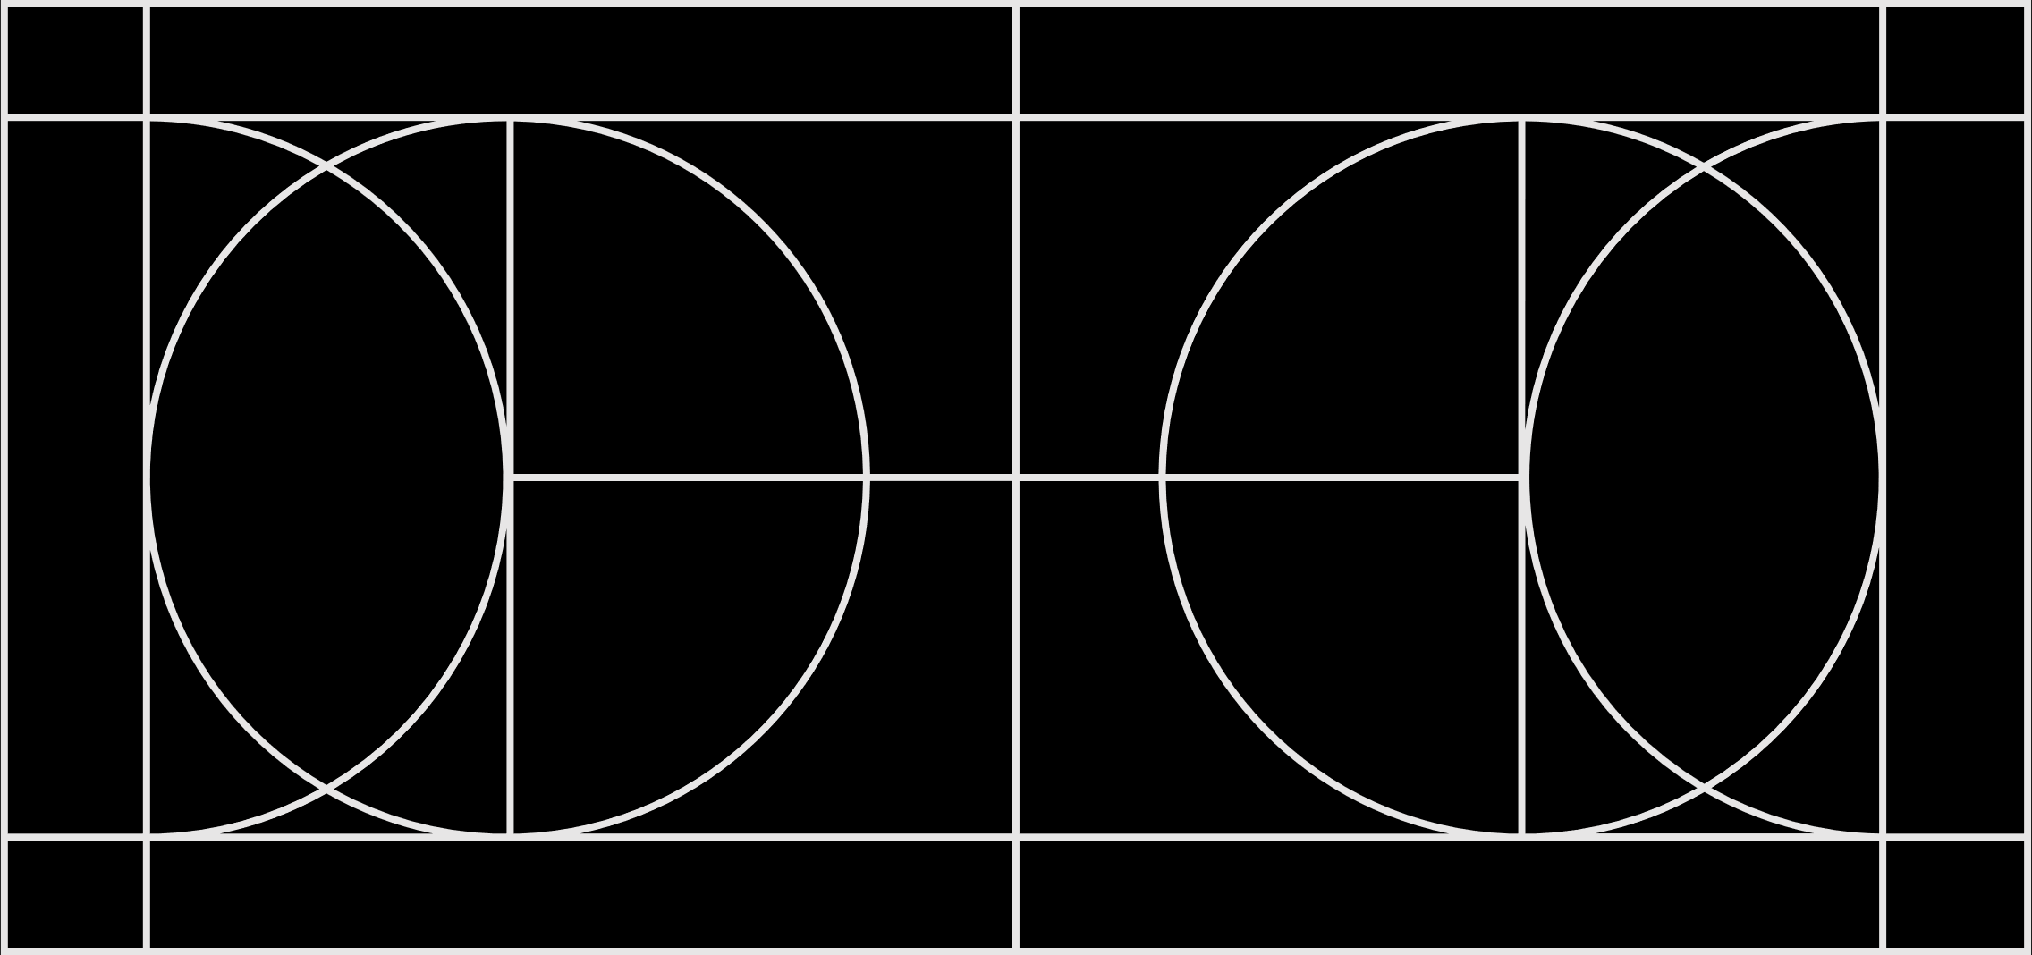
Probability of State change
State j
State i
k steps

Slide 25
Infinite State change

Slide 26
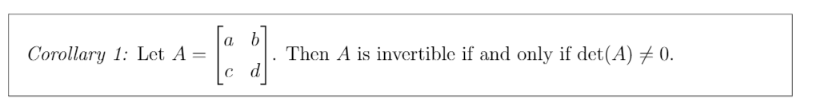
Determinant Invertibility Test
Notes:
They say the same thing.

Slide 27
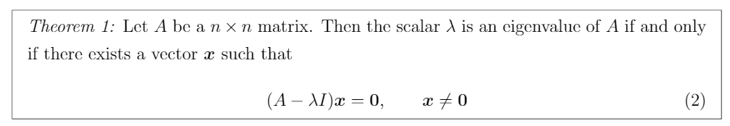
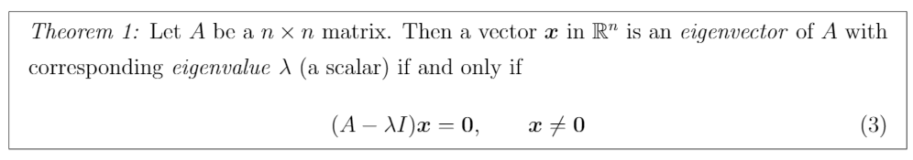
Eigenvalue and Eigenvectors

Slide 28
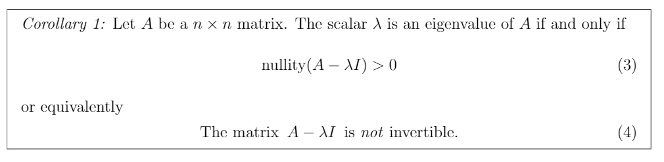
Rule For Eigenvalue
Notes:
Remember that nullity(A) = 0 means only the zero vectors makes the homogenous linear system Ax = b = 0. According to the FTOIM, homogenous linear systems can only have the trivial solution x = 0; therefore, nullity must be zero.

Slide 29
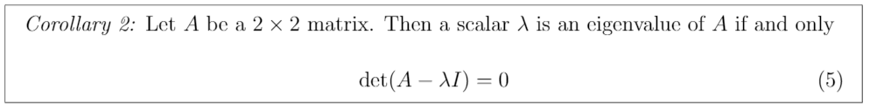
Finding Eigenvalues
Notes:
Solving the determinant for lambda to find the eigenvalues of matrix A.

Slide 30
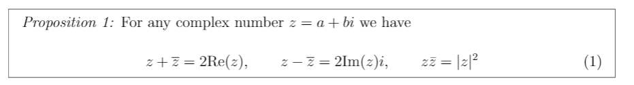
Complex Number Shortcuts

Slide 31
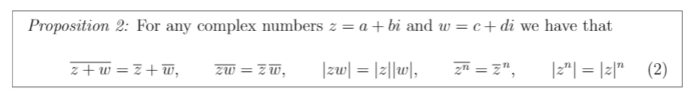
Complex Number Shortcuts

